Slide 1
Personalised Care Planning
Edison Phiri
Anmoal Prashar
Yenny Villaroel Suarez
Practice Development Nurse Acute & Crisis Directorate
Notes:
Edison

Slide 2
Aims
By the end of this session, you will:
  Understand the principles of care planning
  Understand your responsibilities under the NMC
  Be able to create a personalised care plan
Notes:
Edison

Slide 3

Comprehensive Model of Personalised Care
https://www.youtube.com/watch?v=RXOd-7rn6so
Notes:
Edison

Slide 4
Personalised care planning
Personalised care and support planning is a series of facilitated conversations in which the person, or those who know them well, actively participates to explore the management of their health and well-being within the context of their whole life and family situation.
The process recognises the person’s skills and strengths, as well as their experiences and the things that matter the most to them. It addresses the things that are not working in the person’s life and identifies outcomes or goals and actions to resolve these
Notes:
Ams

Slide 5
There is no set template for what a personalised care and support plan should look like, but it should reflect the following:
  A way of capturing and recording conversations, decisions and agreed outcomes or goals in a way that makes sense to the person.
  Should be proportionate, flexible and coordinated and adaptable to a person’s health condition, situation and care and support needs.
  Should include a description of the person, what matters to them and all the necessary elements that would make the plan achievable and effective.
Notes:
Ams

Slide 6
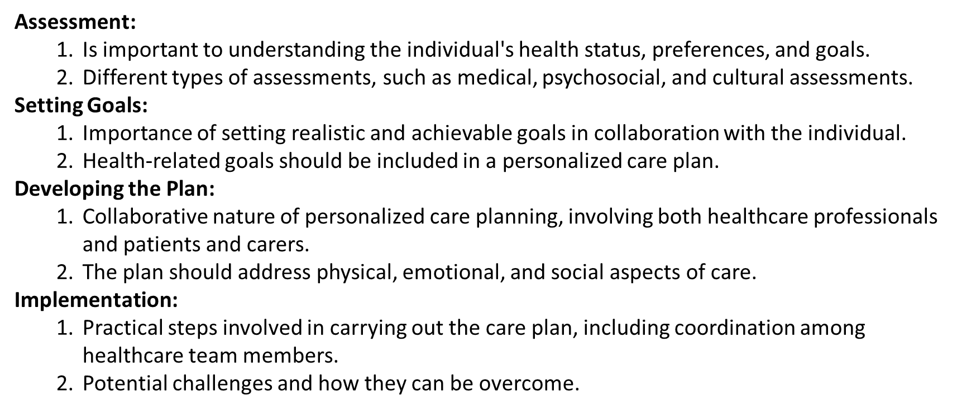
How to implement a personalised care plan
Notes:
Ams

Slide 7
MH – which is more person centred?
Problem | Actions | Clients View
Mental Health: XX suffers from paranoid schizophrenia and depression. She experiences frequent auditory command hallucinations | Primary nurse will form a therapeutic relationship and offer 1:1 interactions per shift. To explore coping strategies Monitor mental health | XX will work with MDT and comply with treatment offered
Mental Health: I hear voices, telling me to hurt myself, at times I get so low and miserable. I feel people are after me, wanting to harm me, so I stay in to avoid people | I will speak to my primary nurse and I will try to use distraction techniques when I hear the voices e.g. listening to music using ear phones, reading newspapers, going for a walk. | I want to feel well and will try to work with my primary nurse and work out what helps me to feel better
Notes:
Yenny

Slide 8
ACS – which is more person centred?
Problem | Actions | Clients View
Maintain good foot health. XX is unable to cut her toenails and needs to see podiatrist every 6 weeks | XX will visit podiatrist every 6 weeks to have toenails cut at clinic To have appropriate footwear | I agree with treatment plan
I don’t want my toe nails to get too long so that it hurts my foot when I am walking | I will try to keep my appointments every 6 weeks and not miss any | If it is too difficult to make the appointment I will try to call beforehand to make other arrangements
Notes:
Yenny

Slide 9
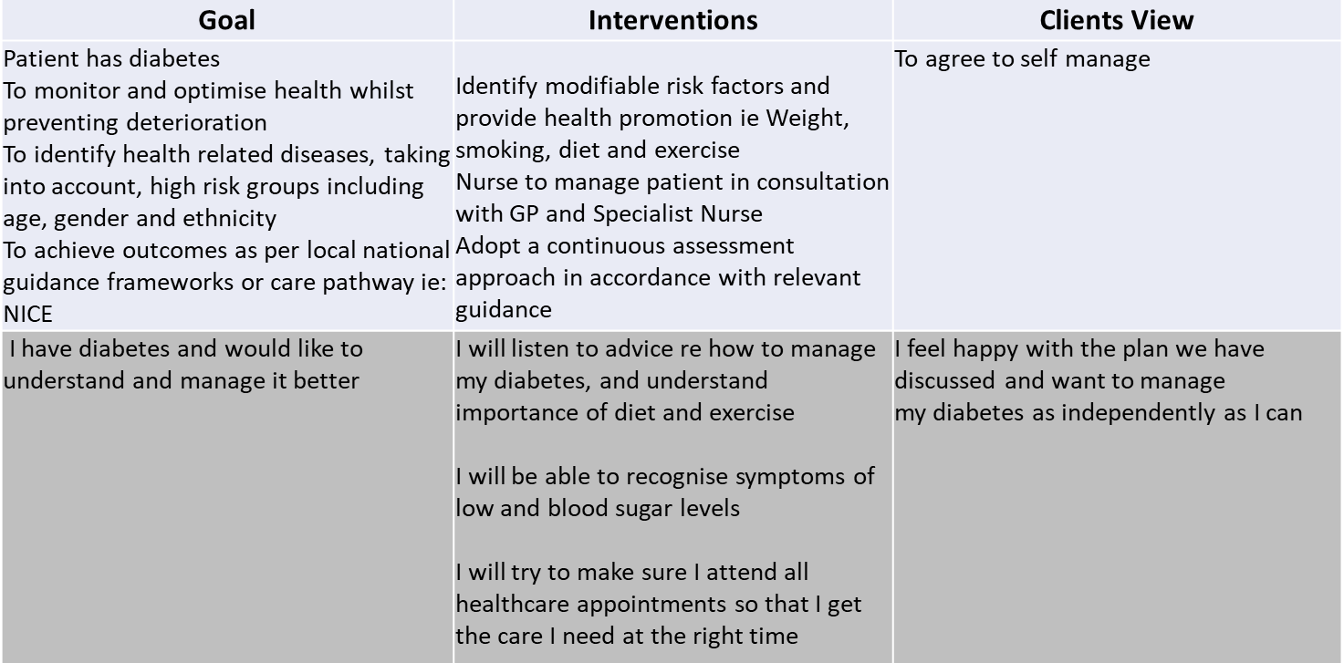
Which one is more personalised
Notes:
Yenny

Slide 10
How to make a measurable goal
Notes:
Yenny

Slide 11
Key considerations
Reflect the patients cultural and ethnic background as well as their race, economic. Disadvantage, age, religions/ spirituality and disability
Consider the role of any family/ carers who are involved
Consider safeguarding concerns
Include crisis and contingency arrangements
Acknowledge areas of difference and disagreement
Identify any unmet needs
Give a date of the next planned review
Communication aids - for example, pictures, symbols, large print, Braille, hearing loops.
Notes:
Ams

Slide 12
Family and carer involvement
Why is family and carer involvement important?
How can we involve them?
Families and carers can play a vital part in keeping their relative or friend well. They often know the people they care for better than anyone else and this knowledge can be useful in planning care with patients.
Their involvement can take many forms and can be anything from getting copies of letters about appointments to full involvement in planning and reviewing care.
All informal carers who provide regular support for a patient are entitled to an assessment of their own needs

Slide 13
Carers Views
A short video on the lived experience of carers
Life Beyond the Cubicle is an exciting Making Families Count project that has produced learning materials which aim to educate and update staff on the importance of involving families wherever possible during mental health crises to improve patient care, avoid harm and reduce deaths.
This an e-learning available on the Oxleas Learning Centre (The Fish)

Slide 14
Activity – Lets care plan!
Activity: Pair Up and Create a Care Plan
Please get into pairs
  Work with a partner to discuss and share ideas
Identify a need of your partners
  Discuss and choose a specific care need
Develop a Care Plan
  Write a care plan addressing the identified need.
  Ensure it reflects person-centered care principles.
  Set realistic and measurable goals
Be Prepared to Share
  You'll have the opportunity to present your care plan to the group.
Notes:
Yenny

Slide 15

What does the NMC code say
The NMC emphasizes the importance of person-centred care and collaborative care planning. Nurses are expected to work in partnership with individuals, their families, and other healthcare professionals to develop and implement care plans that meet the unique needs of each patient.
Person-Centred Care: The care plan should be centred around the individual's needs, preferences, and goals. Nurses should involve patients in the decision-making process and respect their autonomy.
Collaboration: Nurses are encouraged to collaborate with other healthcare professionals, patients, and their families to ensure a holistic and coordinated approach to care.
Assessment and Documentation: Thorough assessment of the patient's health status, including physical, emotional, and social aspects, is crucial. Documentation of the care plan, including goals, interventions, and evaluations, is essential for continuity of care and communication among the healthcare team.
Communication: Effective communication with patients, families, and colleagues is essential for successful care planning. This includes clear and accurate documentation as well as verbal communication.
Evidence-Based Practice: Care plans should be based on the best available evidence and should be regularly reviewed and updated as the patient's condition or circumstances change.
Notes:
Edison

Slide 16
Example one - Fitness to practise referral
Failure to preserve patient safety
Failed to prepare / ensure there was an appropriate care plan in place following the patient’s admission to the X ward
Failed to conduct /ensure that appropriate risk assessments were conducted during the patient’s admission to X ward
Example two – NMC hearing
Failed to ensure that Patient X's care plans were sufficient for his needs in that you:
  a) failed to ensure that the care plans were of an acceptable standard;
  b) failed to ensure that Patient X's family were sufficiently involved in Patient X's care plans and / or care planning
Notes:
Edison

Slide 17
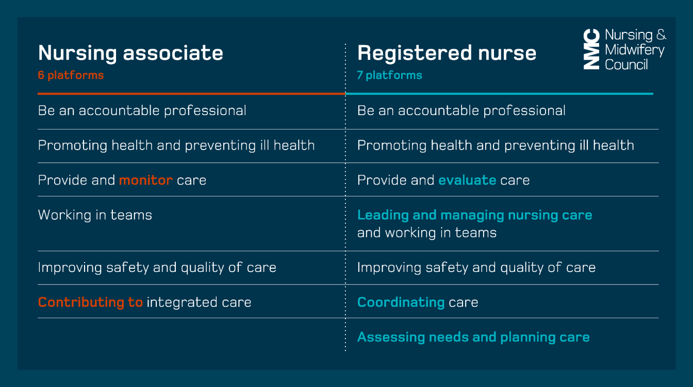
Roles of Nurse and Nurse Associates
Notes:
Yenny

Slide 18
Care planning documents – Oxleas
There is a range of care planning documents that are used across different teams in Oxleas, however the principles remain the same.
  My Care Plan
  Care plan library Inpatient Management
  WAA Acute Inpt/LD Day Service Care Plan
  Intermediate Care Units – My Care Plan
  Dialog+
  SystmOne for prisons
  Oxcare
Don’t get hooked up by the format. All care plans will have:
    Problem/need
    Goal
    Interventions
    Service user views
    Evaluation
Notes:
Ams

Slide 19
Top tips
What's been helpful for you when care planning?
Don’t use professional jargon. Use language the patient understands
Use patients own words and phrases where possible
Make sure the patient feels that they own the care plan by developing it together
Notes:
Ams, Edison, Yenny – joint discussion

Slide 20
Resources
The Ox Care planning (The Ox)
NHS England » Personalised care and support planning

