Slide 1
Supporting you at work and in your professional development
Notes:
The RCN is the world’s largest nursing trade union and professional body.
As a trade union and professional body, the RCN works to ensure the wellbeing of members at work, which ensures the best patient care possible.
Together, we are the voice of nursing in the UK.

Slide 2
We are the world’s largest nursing trade union and professional body
We are nursing-specific, which means we recognise your needs better than anyone else
We support and represent over half a million registered nurses, midwives, health care assistants, health care support workers, assistant practitioners, student nursing associates, nursing associates, nursing students, student midwives and nursing apprentices
We are member-led, not politically aligned, and are
not-for-profit.
Notes:
The RCN is the world’s largest nursing trade union and professional body.
We represent more than half a million nurses, student nurses, midwives and nursing support workers in the UK and internationally.
As a member-led organisation, we work collaboratively with our members to:
influence governments and other bodies
improve working conditions
campaign on issues to raise the profile of the nursing community.
As a trade union and professional body, the RCN works to ensure the wellbeing of members at work, which ensures the best patient care possible.
Together, we are the voice of nursing in the UK.

Slide 3

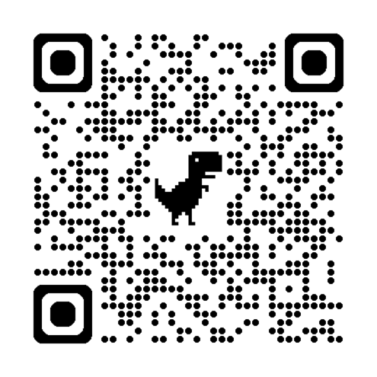
We represent members
The RCN has representatives who are the RCN on the ground. As an RCN member you can become a representative and we provide the training and support for you.
RCN representatives build strong relationships in the workplace and understand how to influence for change. The RCN has three types of accredited rep:
Stewards
Learning rep
Health and Safety rep
Identify and reach out to your local rep today.
Notes:
In addition to online guidance and Advice team at the end of the line, we also have in-person support with RCN Officers and Representatives.
You can become more involved with the work of the RCN by becoming a learning rep, health and safety rep or steward.
Becoming an RCN rep gives you the chance to make a real difference to your patients, the working lives of yourself and your colleagues - and even the future of nursing.
If you are an RCN member and a registered nurse, nursing associate, nursing support worker or health care assistant in employment, you can apply to become an RCN learning representative, health and safety representative or steward. Being a rep is rewarding. You will get support from a close community of reps and RCN staff. Ongoing learning and development will help you become active as a rep and you will learn new skills, which can enhance your nursing role. Students are not eligible to become reps, however, there are other ways you can get involved as a student member.

Slide 4
What are the benefits of becoming a rep?
Secure a better workplace
Organise for change
Develop your own skills:
  Influencing
  Communication and networking
  Negotiating
  Specialist knowledge – health and safety, employment, learning, professional development
Develop others
Amplify voice of nursing
Notes:
There are a number of benefits to becoming a rep, both for you and for your colleagues. It provides an opportunity to develop skills you might not have a chance to in your substantive role and raise your profile at work as well as that of the union. We have learning and development days for reps throughout the year. As a rep you will be the face of the RCN at your workplace for many of your members and will raise your profile across the organisation and the union.

Slide 5

Organising for change
Organising means members and colleagues working collectively to demand change on a range of issues that threaten your ability to continue providing safe and effective care
Be part of the organising movement and take action to campaign for fair pay, create clinical practice changes and ensure safe staffing
Learn more about Organising wins so far and get updates on future campaigns and events – rcn.org.uk/get-involved/organising.
Notes:
Organising is when members come together and through the strength in their numbers, win meaningful improvements and positive change to their lives and workplaces. Groups identify issues, and then collectively work together to bring about solutions on their own terms.
Organising is an opportunity for you and your colleagues to take action on the issues that threaten your ability to practice safely and effectively, from being paid fairly to creating clinical practice changes to having enough staff on shift to deliver safe care.
You and your colleagues are experts in your workplaces and are best placed to speak for your patients and the profession. And when decision makers aren’t listening, organising is way for members to collectively demand change, take action and ensure the right steps are taken by employers.
Across the UK no matter your job, employer, care setting, or issue, you can be part of the organising movement, leading on the issues that matter to you. No matter how big or small. The RCN is with you every step of the way. Together, let’s use our voices to demand the changes we deserve.

Slide 6

We are here for you if something goes wrong
Receive workplace protection with access to the largest in-house legal team of any UK union.
Our workplace representatives and regional officers are on hand should you ever need them, providing much-needed peace of mind.
Member support services:
Free confidential telephone counselling on work or personal issues
Online careers resources and telephone career coaching
Members already in the UK receive free, confidential support and assistance on immigration issues
Financial wellbeing advice from RCN Welfare Services
The RCN Peer Support Service offers members advice and coaching to assist with disability related issues
Notes:
We’re here for you if things go wrong..
With the largest in-house legal team of any UK union, over 1,800 member representatives and officers, and an advice line, we've got your work covered. But what happens when you need support or advice with issues outside of your job?
That's where the RCN's Member Support Services (MSS) comes in; comprising six different teams to guide, empower or help you with aspects such as: your emotional wellbeing, your finances, your immigration rights, your career, or provide support if you have got a disability.
MSS is just one of the very many benefits you'll get from becoming an RCN member. Join today and start benefiting both professionally and personally.

Slide 7






The RCN Institute of Nursing Excellence
The RCN Institute of Nursing Excellence is made up of five new academies, each with a specific focus to drive improvements and innovation.
Notes:
The RCN Institute of Nursing Excellence is made up of five new academies, each with a specific focus to drive improvements and innovation in nursing.

Slide 8

Europe’s largest specialist nursing e-library to help you with your professional development and studies
Over 18,000 ebooks and ejournals, covering every nursing specialism.
We have over 12 databases including CINAHL and the British Nursing Index.
Up to date clinical books and no need to subscribe to nursing journals… it’s all included in your membership!
rcn.org.uk/library
Notes:
You’ll have access to the biggest specialist nursing library in Europe.
Our collection of books and journals includes over 18,000 eBooks and 3,200 eJournals.
Our nursing eBooks and eJournals are available 24/7, are easy and quick to use.
It can be daunting tackling your first assignment, faced with references to find and reading lists to navigate. We are here to help and have a lot of practice at helping new students with their first essay!
We offer online training sessions via Zoom to help you use the online library.
We have created over 60 subject guides which highlight key books and journals in specific nursing topics.
Contact us: email: rcn.library@rcn.org.uk, Phone : 0345 337 3368, webchat via library webpages www.rcn.org.uk/library
Follow us on Twitter, Instagram and Facebook for up-to-the minute news about our services.

Slide 9

Nursing Leadership Academy
Develop an Institute virtual Community of Practice for Members
Establish network, training and roll out at scale of an RCN Mentoring Programme
Executive Chief Nursing Officer network and Global Leadership Summit
leadershipdevelopment@rcn.org.uk

Slide 10
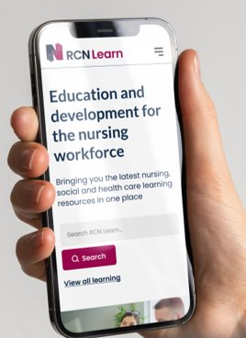
Career development with RCN Learn
RCN Learn has resources to support nurses, nursing students, midwives, nursing support workers and health care professionals at all stages of their career, across health and social care and independent health services.
Unlock expert, quality assured evidence-based education for CPD and learning, whenever it suits you.​
Explore by subject, access level and type of learning, and find the information you need to learn at your own pace. ​
Notes:
You’ll have access to the biggest specialist nursing library in Europe, you’ll have access to RCN Learn.
With RCN Learn, you can:
Gain skills and knowledge to support your nursing studies and career development.
Unlock expert quality-assured, evidence-based learning resources across a range of clinical topics, from online guides and toolkits to podcasts, videos and blended learning courses.
Access wherever suits you – search and filter on multiple devices and browsers.
Explore by subject, access level and type of learning.
Learn at your own pace whether that is to build your knowledge or gain academic credits.

Slide 11
Building RCN leadership reputation
A collaborative leadership hub across the RCN
An interconnected suite of leadership development programmes with mentorship
A networked ecosystem for engagement, discussion and support
Research - economic value of leadership development

Slide 12
Learning and development
RCN Professional Services
Whether you are aiming to improve the culture of leadership within your workplace, enhance your professional skills, or empower your team to implement service innovation, the RCN offers a suite of programmes, courses, and services that will help you improve patient care and experience in the UK.
Forums
Our member-led forums are the professional voice of the RCN. They serve a wide range of specialties across nursing and midwifery, and give members the opportunity to improve their practice and leadership. They also influence and help shape nursing and midwifery practice, education and research. RCN members can join forums at any time.
Notes:
RCN Professional Services provide a range of educational programmes, which can help organisations to improve patient care and patient experience in the UK. Whether you are aiming to improve the culture of leadership within your workplace or empower your team to implement service innovations we have tools to support you.
You can also demonstrate the high standards of your own learning and development initiatives with the RCN Accreditation and RCN Credentialing.

Slide 13
Learning and development
RCN members have access to a wide range of learning resources, courses and professional development opportunities to support continuing professional development. Alongside our learning offers, you will have access to clinical advice, publications, guidance and standards, all accessed via RCN Learn.
Online learning resources
  Bladder and Bowel Learning Resource
  Diabetes essentials
  Medicines management
Bite-sized online learning courses
  RCN First Steps
  Every Nurse an eNurse
  End of Life Care and Wellbeing for the Nursing and Midwifery Workforce.
CPD Courses with academic credits
  RCN Infection Prevention and Control Programme (IPC)
Notes:
The RCN is committed to lifelong learning and the development of all its members and the nursing profession more broadly. The RCN Quality Assurance policy ensures we deliver high quality, evidence-based professional learning resources for the nursing workforce across health and social care.
The nursing workforce are key to the delivery of safe and effective care. Registered nurses and nursing support workers must be appropriately prepared and work within their scope of practice for the people who use services, their families, and the population they are working with. This includes access to CPD, education, support, and development (RCN Nursing Workforce Standards, 2021).
So, whether you are aiming to improve the culture of leadership within your workplace, enhance your own skills and professional development, or empower your team to implement service innovations, we have a selection of free and paid-for courses to support you.
*Please note these courses are not running at the moment.

Slide 14

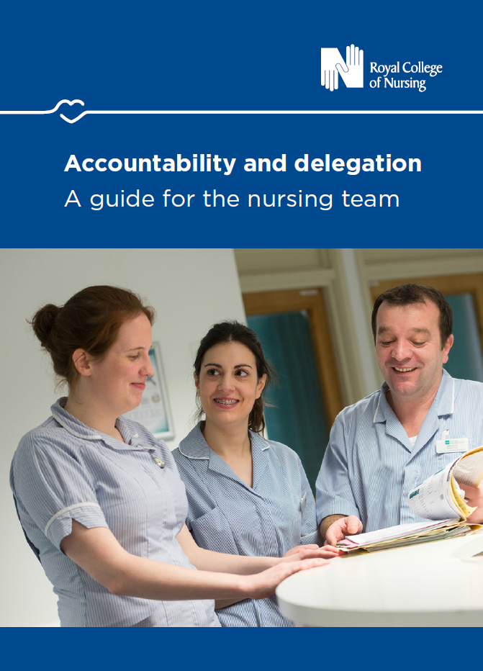
Learning and development
Publications
RCN members have access to a wide range of publications to help develop practice and improve patient care, including record keeping, and accountability and delegation. They can be downloaded free of charge.
Events
Each year we organise a UK-wide programme of professional conferences and events.
There are also a range of events organised by your local branch or RCN office.
Find our more at rcn.org.uk/events
The RCN’s flagship member event is the annual RCN Congress. See rcn.org.uk/Congress for more details.
Notes:
Included in your membership, you’ll also have access to:
Publications
RCN publications cover a wide range of topics varying from clinical guidance to employment relations issues to advice on bullying.
Events
Each year we organise a UK-wide programme of professional conferences and events to help you meet your NMC revalidation requirements or develop professionally. There are also a range of events organised by your local branch or RCN office. The RCN’s flagship member event is the annual RCN Congress, which brings together members from around the UK to discuss key nursing issues.

Slide 15

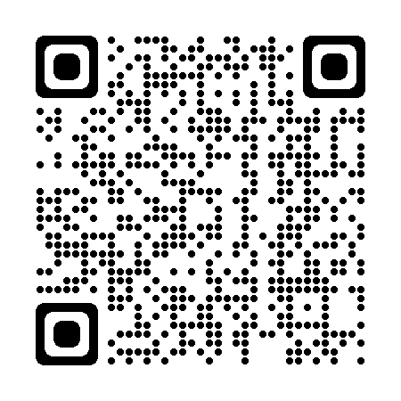

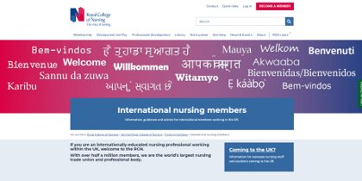
RCN guidance for internationally educated nursing staff (IENS)
Scan here:
International nursing members working in the UK
  @ International Nurses | Royal College of Nursing (rcn.org.uk)
International nurses planning to come and work in the UK
  Information for overseas nursing staff and students coming to the UK
Advice guide for international nurses in the UK or planning to come
  Coming to work in the UK | Advice guides
Scan here:
Scan here:
Notes:
The RCN has several resources available specifically for international nursing staff.​
​
A page for international nursing members who currently work in the UK, to show how the RCN can support you and signpost you to further resources​
A page for international nursing members who are planning to come to the UK, to explain what you should know beforehand​
An advice guide for international nurses coming to the UK for the first time and for those already working here. Includes:​
Benefits of joining the RCN​
Coming to the UK: What is the NHS?​
Coming to the UK: What is the NMC?​
Coming to the UK: What are my career options?​
Coming to the UK : Registering as a nurse or midwife​
Coming to the UK : Examinations and tests​
Coming to the UK: What is revalidation?​
Contracts: What to check​
Once signed, can it be changed?​
Contracts: Repayment clauses​
Contracts: Paying an agency a work-finding fee​
Discrimination​
Immigration: Leaving employers and your visa/sponsorship​
Immigration: Bringing family to the UK​
Immigration: Spouse/partner working in the UK​
Immigration: County court judgement your immigration status​
Immigration: Problems with your employer or agency​
Maternity leave and pay​
Strike information for internationally educated nursing staff​
Tax​
When to contact us
Click on the links or scan the QR codes to find out more information.

Slide 16
Any questions?
charlotte.daus@rcn.org.uk

